Slide 1

राष्ट्रीय प्रौद्योगिकी संस्थान पुदुच्चेरी
NATIONAL INSTITUTE OF TECHNOLOGY PUDUCHERRY
(An Institute of National Importance under MoE, Govt. of India)
KARAIKAL – 609 609
Final Year project - Final Review Meeting
AI Based Design for Frequency Selective Surface (FSS)
Project Guide
Dr. Boopathi Rani R
Assistant Professor,
Depatment of ECE,
NIT Puducherry, Karaikal,
India
Presented by
KAPA ADHEESHWAR REDDY
Reg No: EC21B1023
SADHU POORNA SAI
Reg No:EC21B1043
SANAPALA CHANDRA SEKHAR
Reg No:EC21B1044
B.TECH Department of ECE,
NIT Puducherry, Karaikal,
India

Slide 2
Introduction:
What is Frequency Selective Surfaces (FSS)?
Frequency Selective Surfaces (FSS) are specialized structures used in modern wireless communication systems.
They play a crucial role in filtering, controlling, and modifying electromagnetic waves.
Applications of FSS:
FSS is used to enhance the performance of antennas by filtering specific frequencies.
FSS helps in shielding electronic devices from unwanted electromagnetic interference.
FSS structures are integral in managing signal propagation and improving overall system efficiency.
Challenges in FSS Design:
Traditional Design Methods: Designing FSS typically involves iterative processes that are computationally expensive and time-consuming.
Complexity: Achieving the desired electromagnetic properties through traditional methods requires significant expertise and resources.

Slide 3
Problem Statement:
Designing FSS with specific electromagnetic properties traditionally requires significant computational resources, expertise, and time. Additionally, managing large datasets for AI-driven designs is a challenge. The need arises for more efficient, data-driven models that maintain high accuracy while reducing the computational load. This project aims to develop AI-based models that address these challenges, improving the design efficiency of FSS for applications in wireless communication, antenna design, and electromagnetic shielding.
Objectives:
Develop an AI-Based FSS Design Framework: Implement an efficient design method for Frequency Selective Surfaces (FSS) using a deep neural network-based to predict transmission coefficients.
Enhance Optimization Efficiency: Integrate the Optimization algorithm with the deep neural network to iteratively optimize FSS structural parameters, achieving faster convergence with high accuracy.
Improve Design Accuracy: Achieve accurate FSS design results by minimizing errors in transmission coefficients at key frequency points.
Reduce Computational Time: Increase design efficiency compared to traditional methods, making FSS design faster and more adaptable for practical applications.

Slide 4
Methodology
Data Preprocessing
Simulation datasets with structural parameters (`s [mm]`, `w [mm]`, `w2 [mm]`) and S21 values in dB were imported and grouped into a consolidated dataset for training and analysis.
Feature and Target Preparation
Structural parameters served as input features, while S21 values in dB were the target output. The data was split into training, validation, and test sets.
Network Design (FPN)
A deep neural network with layers structured as 64, 128, 256, 128, and 71 neurons was designed with LeakyReLU activation and dropout layers, enabling it to model the relationship between structural parameters and S21 values.
Optimization (IPSO)
The IPSO algorithm, with adaptive inertia weighting, optimized structural parameters for target S21 values at specific frequencies by adjusting particle velocities and positions.
Fitness Evaluation
IPSO minimized the difference between predicted and target S21 values over 200 iterations.
Results
Optimized parameters were used in the FPN model to predict S21 values, which were plotted against targets to assess design accuracy.

Slide 5
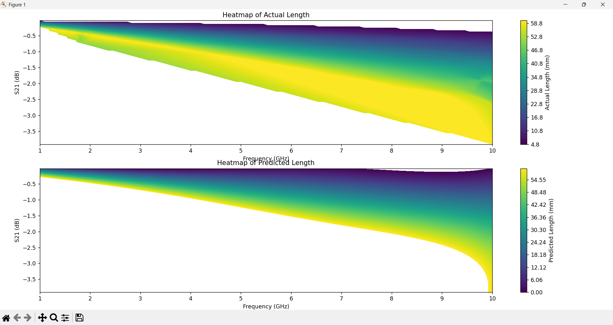
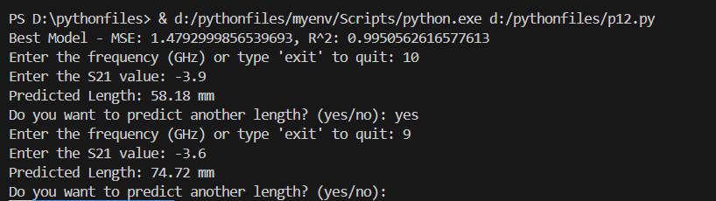
Design of MicroStripline
Key Outcomes :
The predicted length of the microstrip line represents the maximum achievable length based on the input frequency and S21 values.
Using Ridge Regression it enhances model accuracy by capturing non-linear relationships. It includes detailed parameter tuning with GridSearchCV, better data handling, and visualization through heatmaps.
Input
AI MODEL
FOR LENGTH PREDICTION
Frequency
Output
LENGTH
S21 VALUE
Fig(1). Block diagram of Model 2
5
Fig(2). Output of Model 2B
Fig(3). Heatmap visualization of Frequency vs S21 for Actual length and predicted length values

Slide 6

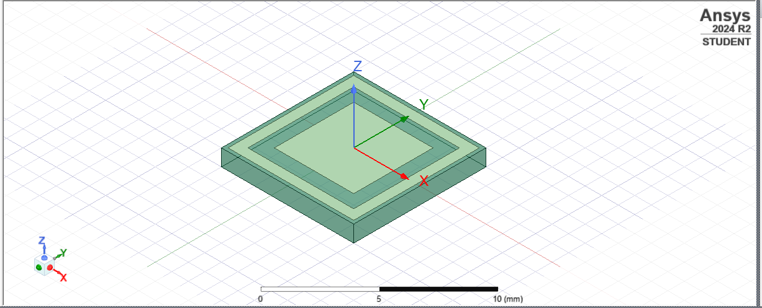

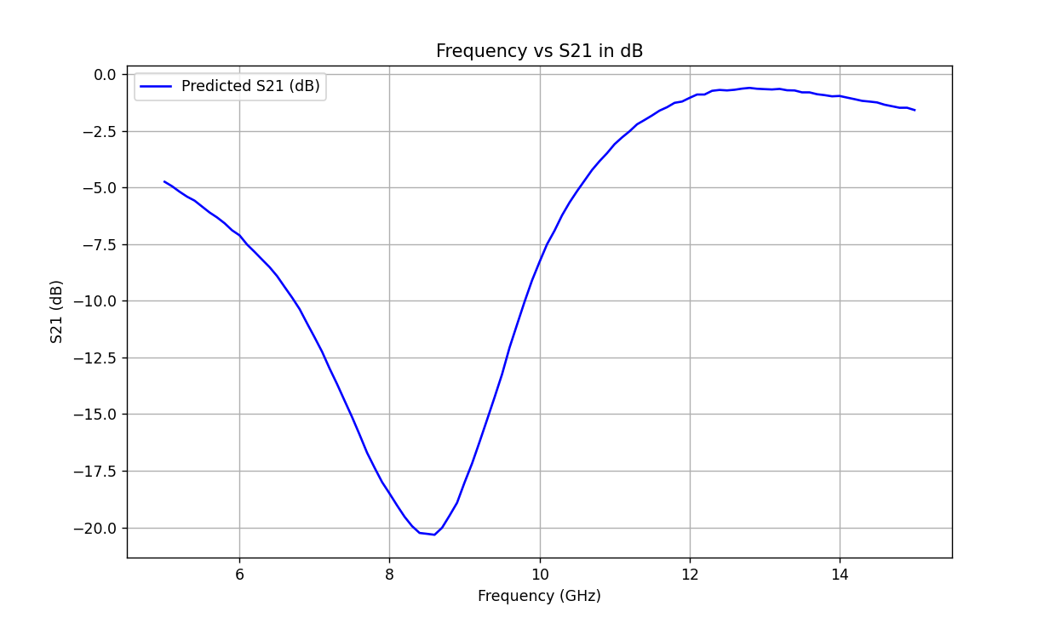

Frequency Selective Surfaces (FSS) Design :
Copper
Substrate
Output:
S21 Prediction Results
Final Training Loss: 14.633203506469727
Final Validation Loss: 14.026500701904297
Optimal FSS parameters
(L1, L2, L3): [2.800000 3.462830 2.000000]
Fig(5).Simulation Image of FSS in HFSS Software
Fig(4).Output of the Model (Optimal Parameters)
Key Outcomes:
The plot of predicted S21 values closely align, confirming high prediction accuracy.
The use of IPSO for parameter optimization improved the model’s performance by accurately tuning structural parameters to meet target S21 values at specified frequencies.
Fig(6). Visualization of Freq(GHz) vs S21 of Predicted Values (dB)

Slide 7
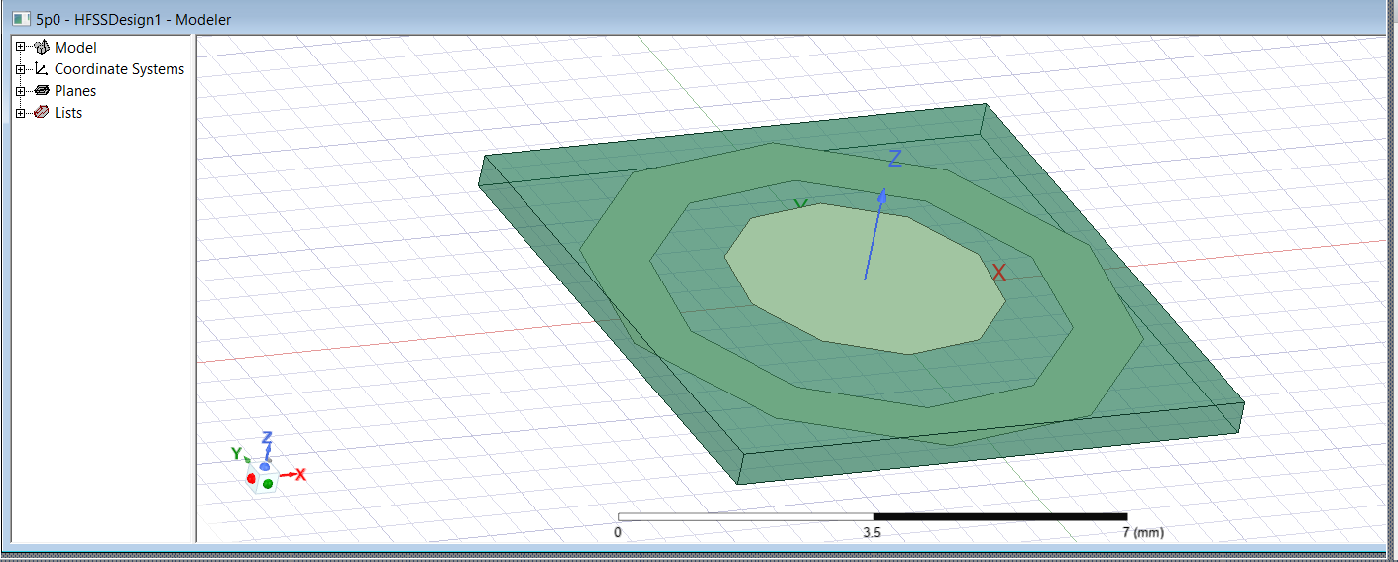
Frequency Selective Surfaces (FSS) Design :
Fig(7).Simulation Image of FSS in HFSS Software
Copper
Substrate

Slide 8

Results
Performance: The FPN model achieved Mean Squared Error (MSE) and Validation Loss within acceptable limits, indicating good predictive accuracy for S21 values.
Key Outcomes:
The plot of predicted S21 values closely align, confirming high prediction accuracy.
The use of IPSO for parameter optimization improved the model’s performance by accurately tuning structural parameters to meet target S21 values at specified frequencies.
Output:
S21 Prediction Results
Final Training Loss: 24.9625
Final Validation Loss: 24.7155
Optimal FSS parameters
(S, W, W2): [6.81 1.0 1.0]
Fig(8).Output of the Model (Optimal Parameters)

Slide 9
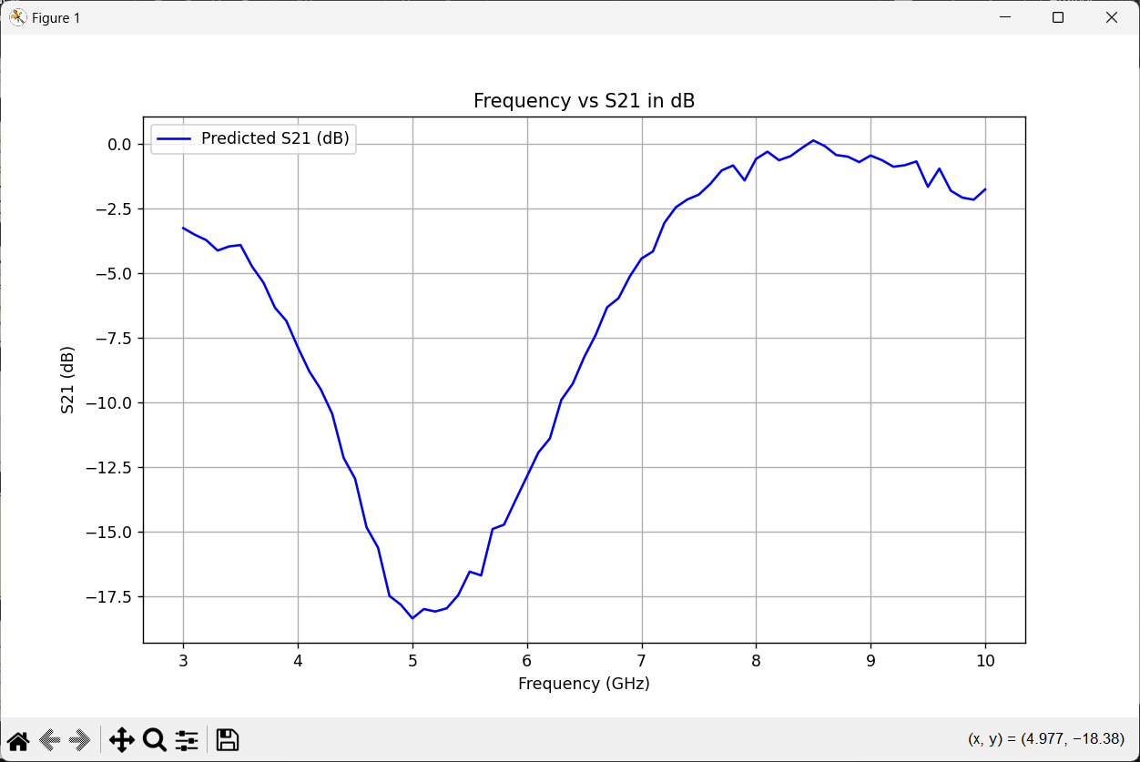
Visualization :
Fig(9). Visualization of Frequency(GHz) vs S21 of Predicted Values (dB)

Slide 10
Conclusion :
Effectiveness of AI: AI demonstrated strong potential in automating and enhancing the design process for Frequency Selective Surfaces (FSS), showing high accuracy in predicting frequency responses.
Optimization Capabilities: The developed Forward Prediction Network (FPN) and IPSO-based optimization provide a reliable framework for optimizing structural parameters, minimizing design iterations, and increasing adaptability to target specifications.
Streamlined Process: This AI-driven approach significantly simplifies the FSS design workflow, enabling efficient alignment with precise performance targets.
Feasibility and Accuracy: The close alignment between actual and predicted values validates the effectiveness of machine learning for automating and refining FSS design, ensuring both feasibility and accuracy in real-world applications.

Slide 11
References :
R. Cong, C. Zhang, N. Liu, K. Yang, X. Gao, and X. Sheng, "A Novel Method for Frequency Selective Surface Design Using Deep Learning with Improved Particle Swarm Algorithm," 2022 IEEE the 9th International Symposium on Microwave, Antenna, Propagation and EMC Technologies for Wireless Communications (MAPE), 2022, pp. 374-379, doi: 10.1109/MAPE53743.2022.9935221.
Thank You

